Slide 1
Cyberbullying – A Parents Guide

Slide 2
Cyberbullying
the use of electronic communication to bully a person, typically by sending messages of an intimidating or threatening nature.

Slide 3

Emotional signs of bullying
Isolating themselves and not talking to the family
Feeling withdrawn and spending more time alone
Changes in eating habits
Changes in behaviour such as feeling more angrier than usual
Avoiding social media
Not seeing their friends after school or at weekends
Anxiety and nervousness that wasn’t displayed previously
To block or report someone
go to the chat with the person you want to report
tap on the group or person’s name to open their profile
scroll down and press Report
you can also block the person on this page.

Slide 4



Included in the presentation
An age related guide for parents, but it is up to you to decide if your children are sensible enough to use them.
Online gaming and…..
Social Medial Apps
    13 yrs 13 yrs 16 yrs

Slide 5

Group Chats – where the bullying starts
Online groups are one of the most common ways children communicate with each other , and from spending time in lots of schools, this is where the bullying starts
The group may include the whole class or a few select friends. They must never invite people to join that aren’t known by everyone in the group
After speaking with a lot of Young People they clearly believe that deleting something disappears forever.
Ensure they have someone to confide in, such as a Trusted Adult, if an instance of bullying or harassment occurs. Even if they too may get into trouble, and that it’s best to be honest than caught out.

Slide 6
Snapchat
Snapchat is a photo and video sharing app that allows users to communicate with friends, family, and followers by snapping and sharing photos in an instant.
Set Privacy Settings Users are able to determine who can contact them, view their story, see their location, or if they appear in quick add.
Sending Snapchat photos; the sender can chose between 10 second and an unlimited amount of time other users can view them.
Stories are viewable for up to 24 hrs, but this can be deleted beforehand
Screenshots; Senders are notified when someone takes a screenshot of their Snaps but they have no control over recipients doing this and can’t stop them from taking a screenshot or sharing it with others.
Bullying; Our young people sometimes get pressured into sending photo’s and videos, or don’t think about what they are sending, this can lead to serious abuse. They now feel like they have no one to turn to.
Snapchat also features Snap Map, allowing users to view the exact location of their friends; a feature that will be unsafe for most kids and teens. A user’s status on the Snap Map can be turned off in settings by switching to Ghost Mode

Slide 7
TikTok is a free social media app that lets you watch, create, and share videos
Use privacy settings to limit how much information they can share to stop posting videos immediately without first reviewing or editing them, kids can upload impulsively.
Screen Time Management: this setting limits users to a maximum of two hours on the app per day, it can be limited to 40 minutes. You can set a password on their phone to lock the setting
Restricted Mode: Blocks mature content, you can also lock the setting with a passcode
Set up Family Pairing, this allows you to managed the above setting. You will need to download the app first.

Slide 8



GAMING
Can be a great way of interacting with others in an exciting way.
Unfortunately, Children can be bullied for not playing a specific game, or have the Fear Of Missing Out.
Being deliberately excluded from a game by their friends, or criticised for how they play.
Other players may swear or use abusive language over voice chat, and this can be upsetting for your child.
Gaming can be an open platform for Grooming, especially as there are voice changing headset that allow an adult to sound like a child

Slide 10
Games accessed through ROBLOX
There are many free games that can be accessed via Roblox – such as
Jailbreak
MeepCity
Tower of Hell
Piggy
HuggyWuggy
Five Nights at Freddies

Slide 11
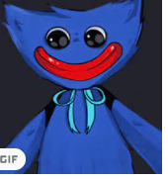
Huggy Wuggy
https://www.youtube.com/watch?v=-Nc7kZBa6_U

Slide 12
Five nights at freddies
https://www.youtube.com/watch?v=mvqVT6GCx2I

Slide 13
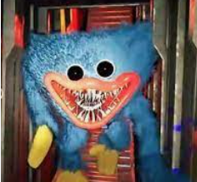

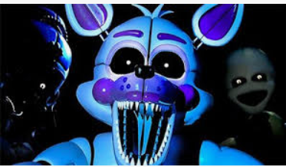
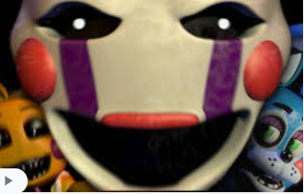
Poppy Playtime / Huggy Wuggy: features frightening images and themes that are paired with child-friendly items. This may be especially upsetting to children who have not yet developed the resilience to deal with disturbing content.
Five Nights at Freddy's is all about heart-pounding jump-scares. It's rated 12+, so it's not quite suitable for many preteen players. It’s all about putting the players through terrifying shocks.

Slide 14
Victims of Cyberbullying – what to tell your child
Don’t keep it to yourself or try to deal with it alone. Tell an adult you trust. It can help to talk.
Don't reply to any nasty messages you receive. Keep the messages that you've been sent so you can show someone, screenshot everything.
Don't share, comment, or like any bullying posts. Sharing or commenting could make the bullying worse, plus, the child now becomes guilty by association.

Slide 15
Consider the Police?
It’s a criminal offence if the cyberbullying is causing ‘alarm or distress’ to the victim (under the Harassment Act 1997).
Or can be considered ‘grossly offensive’ (Malicious Communications Act 1988 and the Communications Act 2003).
Hate crimes are any crimes that are targeted at a person because of hostility or prejudice towards that person’s:
disability
race or ethnicity
religion or belief
sexual orientation
transgender identity

Slide 16
Parental Controls
Parental controls allow you to block and filter upsetting or inappropriate content. They work across your WiFi, phone network, individual apps and devices.
Parental controls can help you to:
plan what time of day your child can go online and how long for
create content filters to block apps that may have inappropriate content
manage the content different family members can see.

Slide 17
Passwords
Write every app and game that requires a password into a book and keep it at home.
Use 3 random words, add numbers and symbols.
Check how safe is the password at :
https://www.security.org/how-secure-is-my-password/
For example : coffee2022 - would take just a day to hack
coffee2022piggy – would take a thousand years

Slide 18
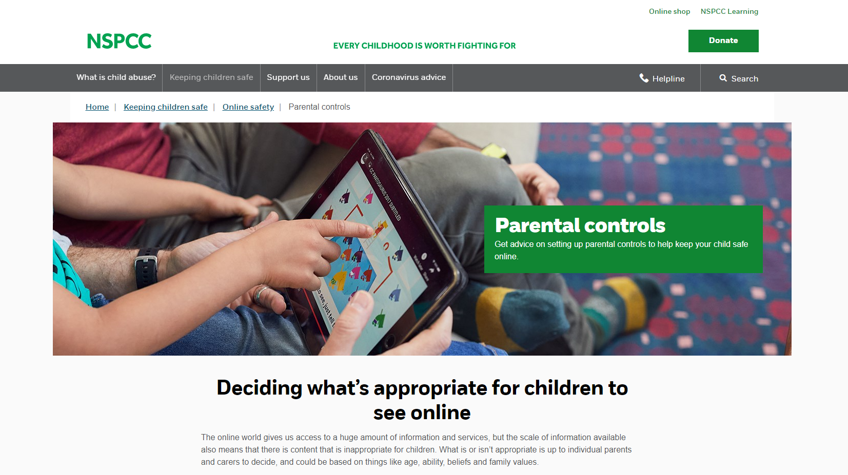
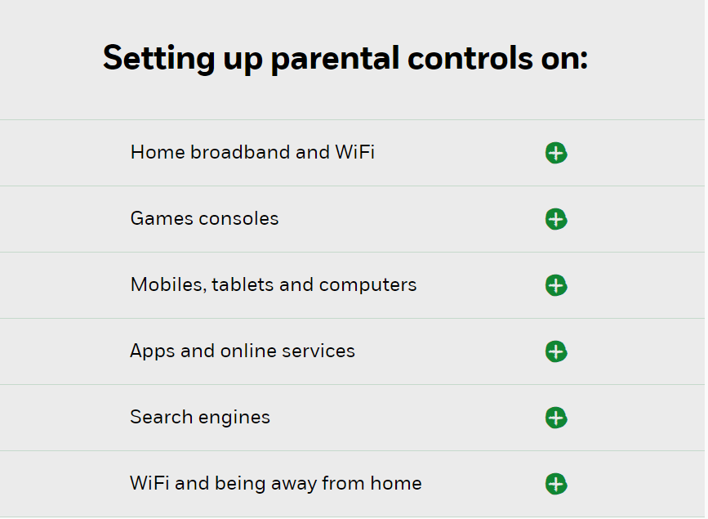

Slide 19
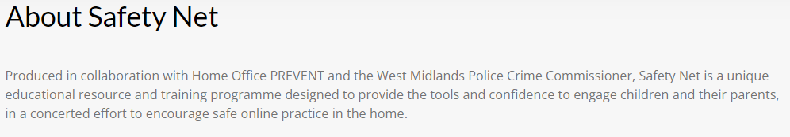
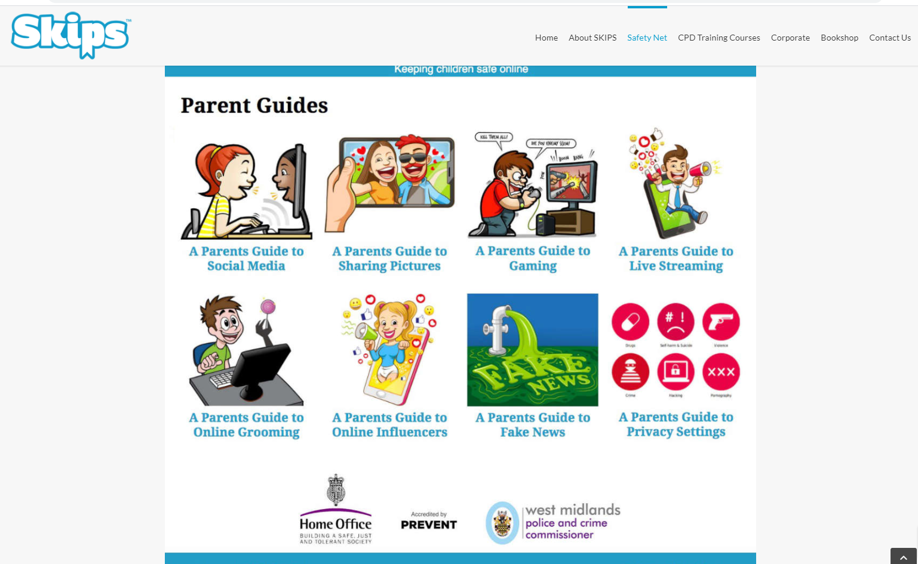
www.skipseducational.org

Slide 20


